Slide 1


Project Code: MEx
Hanoi, September 1st 2017

Slide 2



Team Members
Supervisor
Mr. HOANG XUAN SON
Do Cao Phong
Pham Minh Hoang
Luyen Bao Anh
Le Xuan Huong
Phung Duc Luat
Dang Ngoc Tu
Software Developer
Hardware Developer
Team leader
Technical Leader
QA Leader
Test Leader

Slide 3
Presentation Agenda
1
Introductions
Project Management
2
3
System Specifications
Implementation & Testing
4
5
Product Demo – Q&A

Slide 4
1. INTRODUCTION
How do we get the problem ?
How did the idea come to us ?

Slide 5
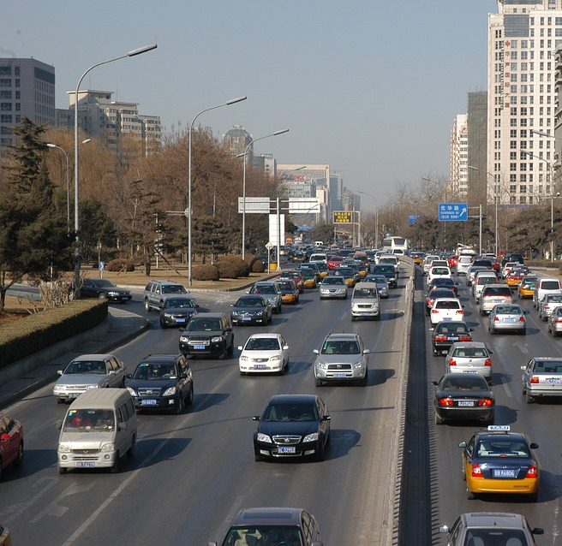
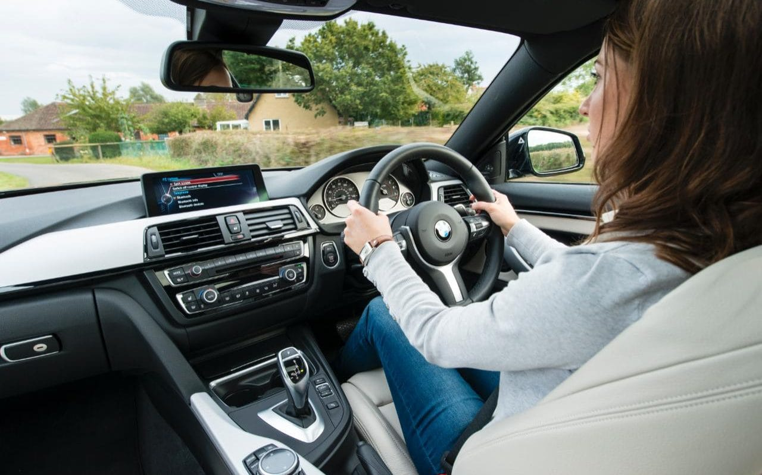
THE PROBLEM

Slide 6
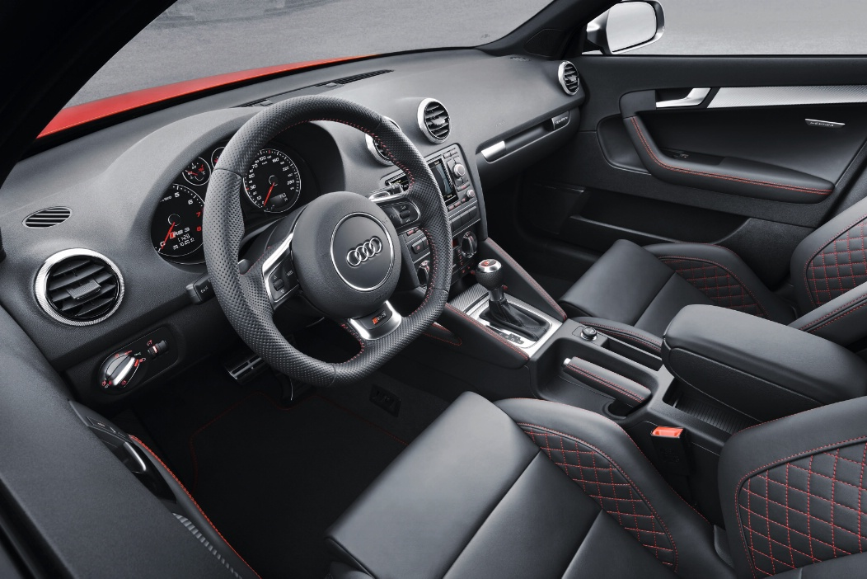

IDEA
Create a remote control automobile model.
Make a remote controller to simulate driving.
Develop an application with Virtual Reality Technology to bring new experience.

Slide 7
2. PROJECT MANAGEMENT
System development plan
Risk
Management
plan
Development
tools

Slide 8
System Development Plan
Process Model
Requirement
Implementation
Initial Planning
Deployment
Evaluation
Testing
Iterative and Incremental Software Process Model

Slide 9
System Development Plan
Team working
01
Working everyday
Spend 3 hours per day and 5 days per week.
02
Meeting every week
At FPT University Hoa Lac Campus
03
Keeping in touch on social network
Send report at Facebook and join regular meeting at Skype
04
Getting feedback from supervisor
Meeting supervisor once per week

Slide 10
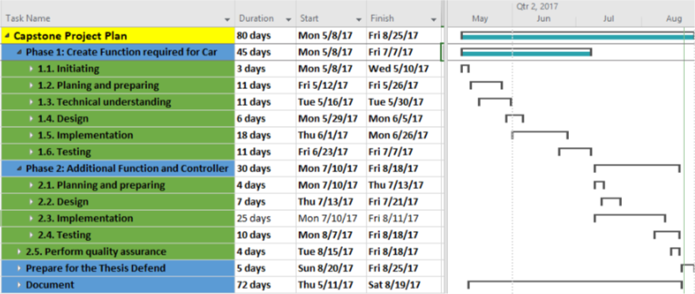
System Development Plan
Project Plan

Slide 11
















Development Tools
4
3
2
Operating Systems
Programming Languages
Electronic Design Tools
Others:

Slide 12
Risk management plan
Description | Avoidance plan | Contingency plan
The People | Team members may get some problems like illness, miscall, or having bad situation with health. | As soon as possible communicate with teammate and create a small meeting.
Hardware | Configuration and testing make devices or module broken. | As soon as possible replace or buy new devices. Read correctly datasheet.
Environment | In testing time, environment is wet, rain or hard to get Wi-Fi signal | Change time to re-test the test case or change location
Time | Team members have problem with schedule | Team leader creates new instance plan, make the project meets deadline

Slide 13
3. SYSTEM SPECIFICATIONS
Non-functional
Requirement
Business analysis
Functional
Requirement

Slide 14

Business Analysis
Audi A1 Sportback

Slide 15
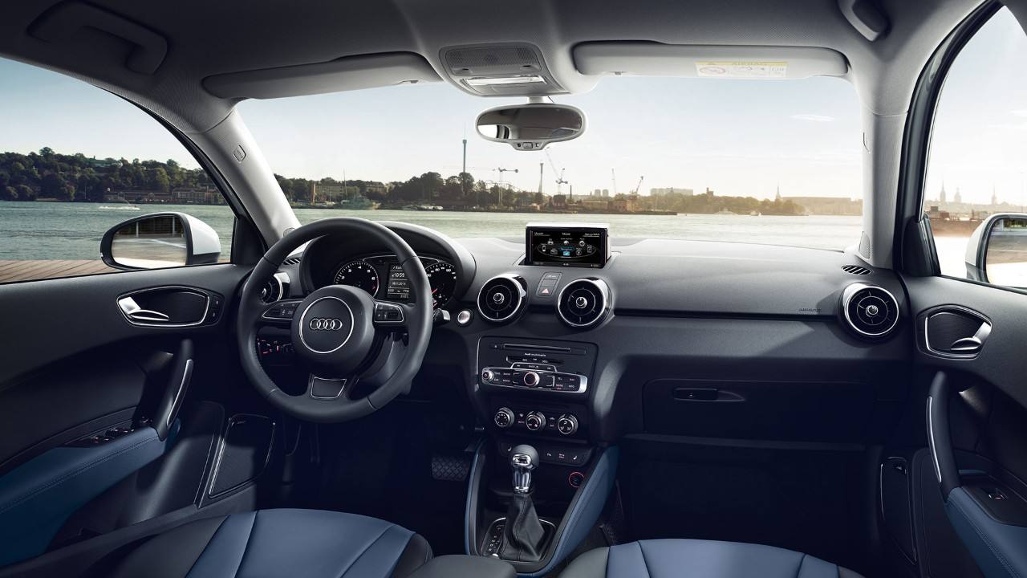
Business Analysis
1 rounds
Steering wheel
4 rounds
Indicators stick
3 gears
Brake
pedal
Accelerator
Automatic transmission
7 gears
Handbrake

Slide 16
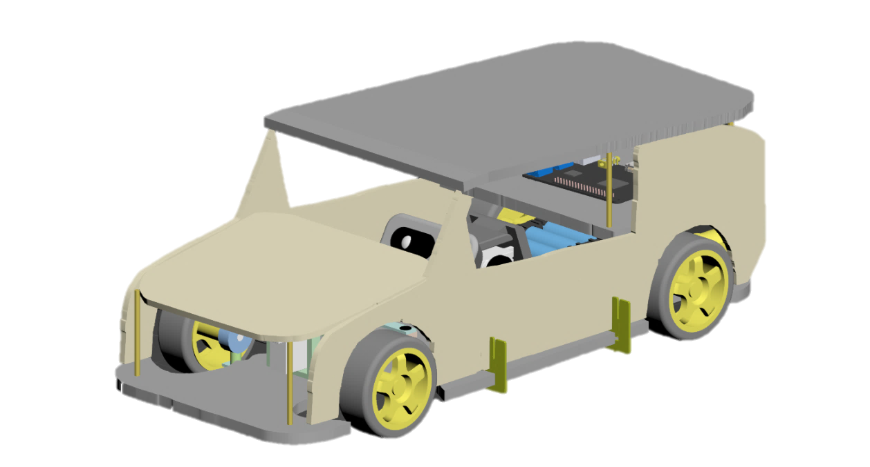

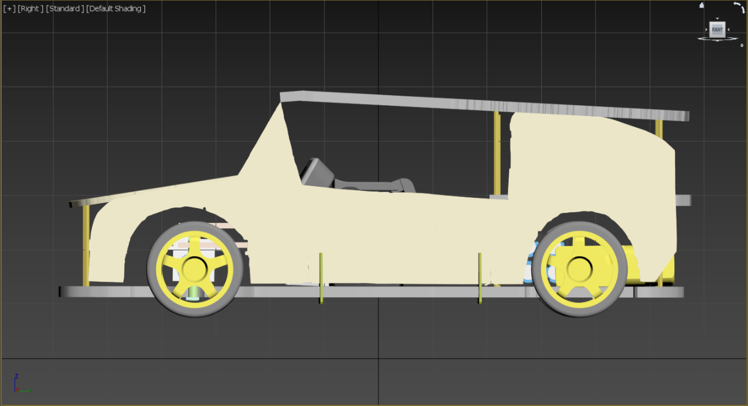
Automobile Model
Concept design

Slide 17
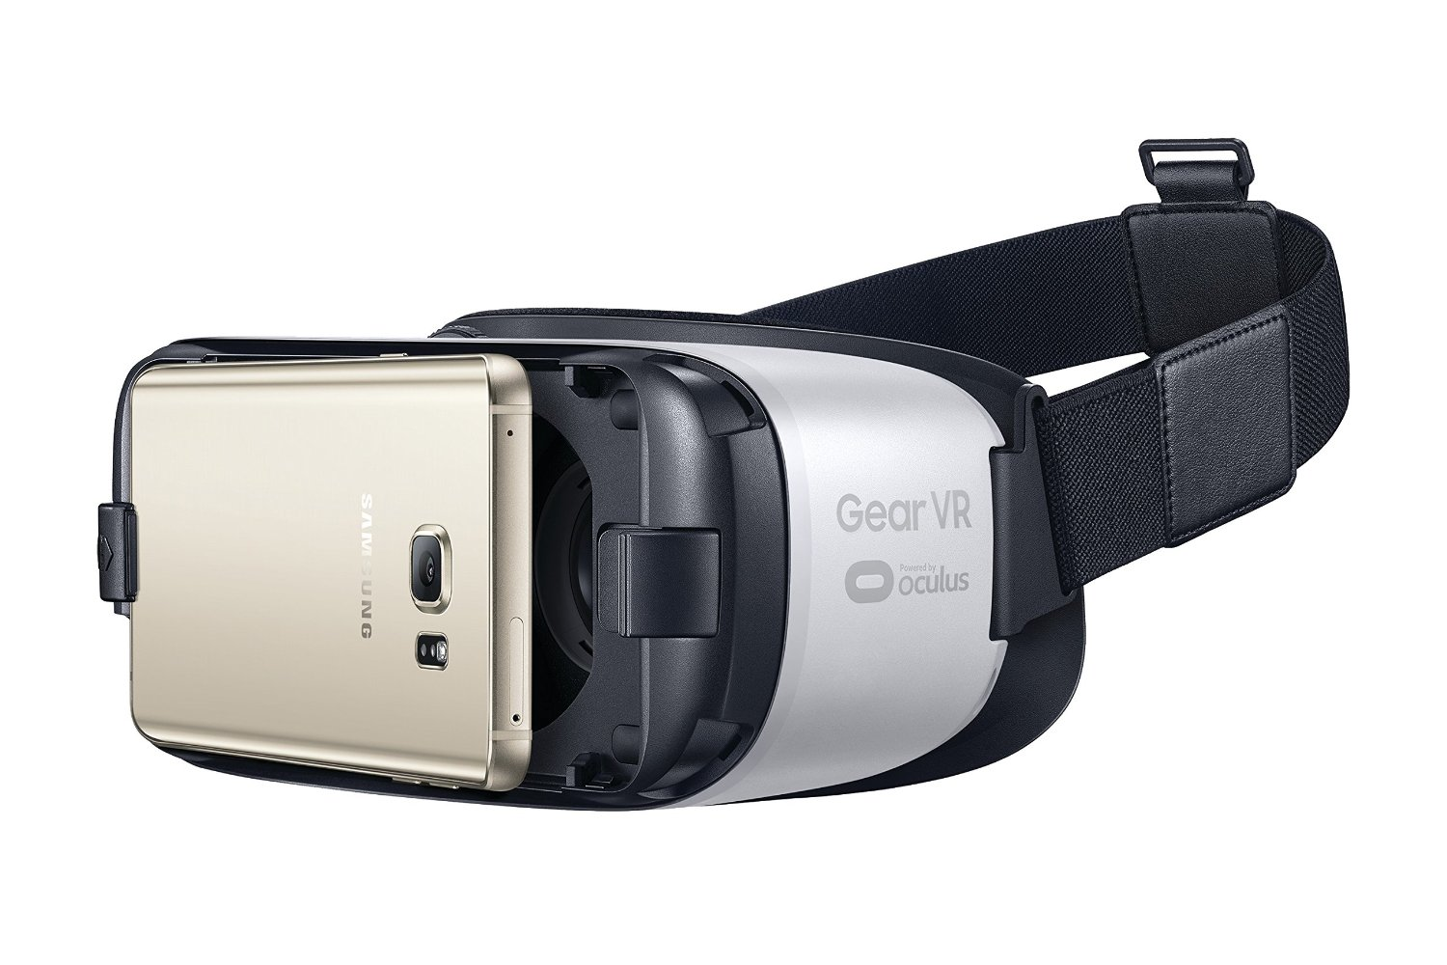


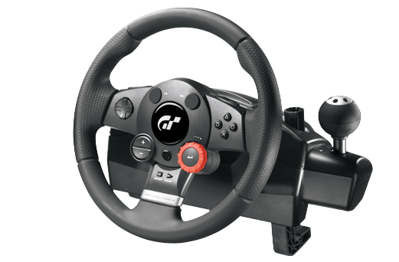
Functional Requirement
Control command
Media stream
Wi-Fi
Control command

Slide 18
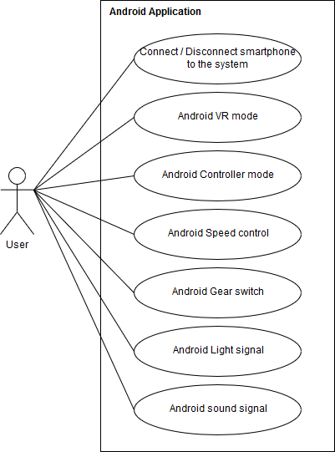
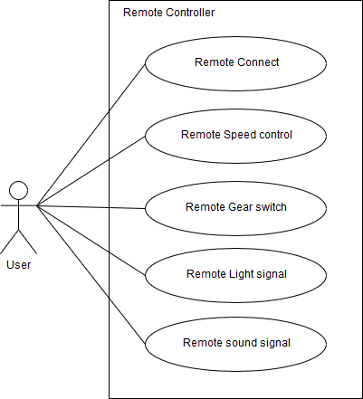
Functional Requirement

Slide 19





Non-Functional Requirement
02
01
Maintainability
Reliability
Flexible mechanical designing to make it easy to replace any robot components.
The hardware components are all available, and easy to purchase.
There is at least 95% of user command that will be successfully sent and executed to the car.
04
03
Security
Performance
Wi-Fi network secure by WPA method. Each device has own SSID and Password.
Just allow max one Android Device and one Remote Controller at the same time.
The car has to response one user command in less than 0.1s.
Media streaming has delay time less than 0.2s

Slide 20
3. IMPLEMENTATION
System Architecture Design
Software & Hardware Design
Hardware device list
Mechanism Design

Slide 21
System Architecture Design
Android
App
Raspberry Pi 3
Microprocessor
Wi-Fi module
Client App
Camera
Sensors
Servo
DC Motors
Motor Driver
Power supply
Wi-Fi module
Microcontroller
Indicators
Pedals
Steering wheel
Server-side
Client-side

Slide 22
Software Design
Server-side process
Start
Open HTTPServer port 8012
Open socket port 8011
Decrypt request and try to execute
F
Is the request is disconnect?
T
Wait for a client connect
F
Receive request
Wait for a client connection
There are a request connect?
Have a client connect?
F
T
T
T
This device is Android?
F
Android device are in VR mode?
T
Close connection to device
Get authentication
information
Send media response
F
F
Can authenticate device?
T
The limitation of device is reached?
T

Slide 23
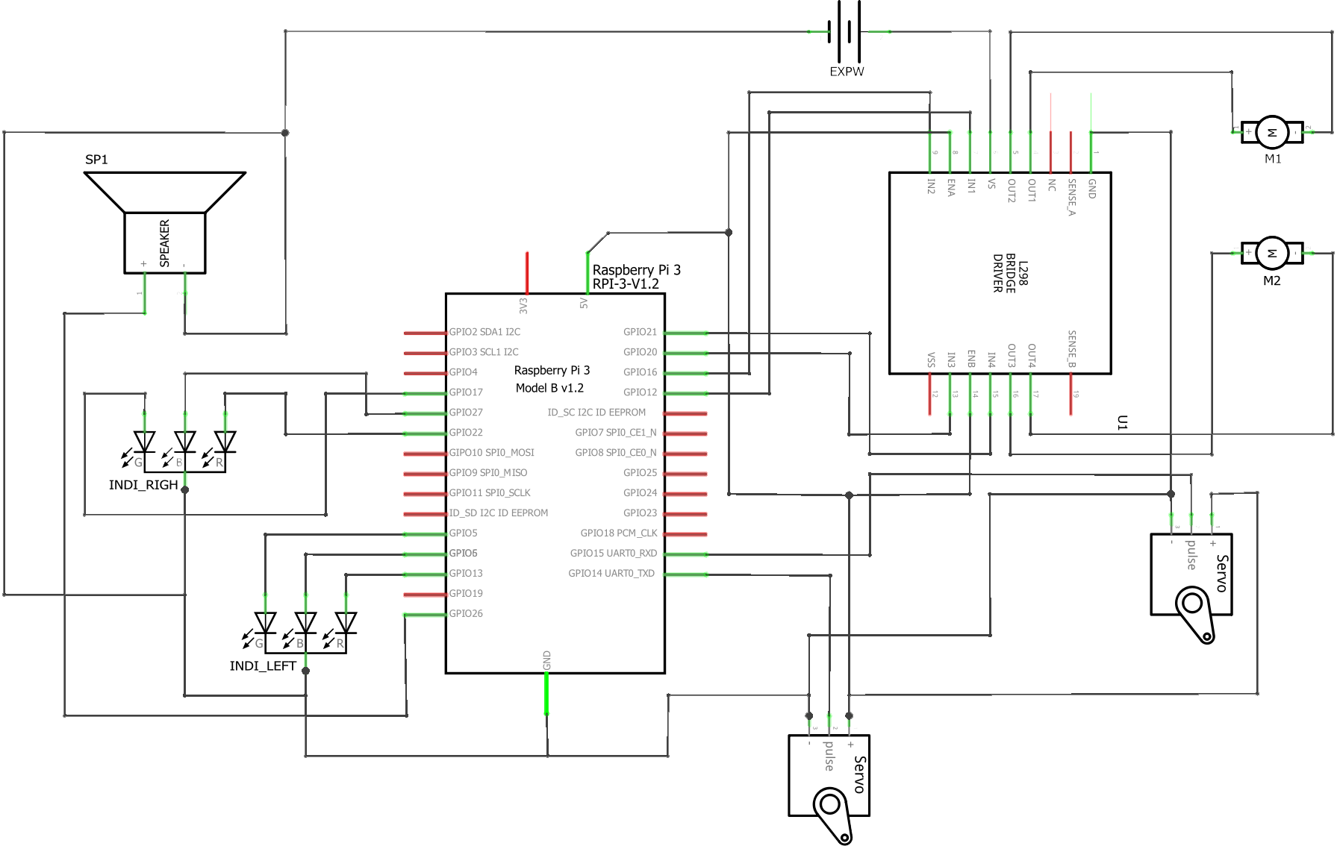
Hardware Design
Schematic

Slide 24
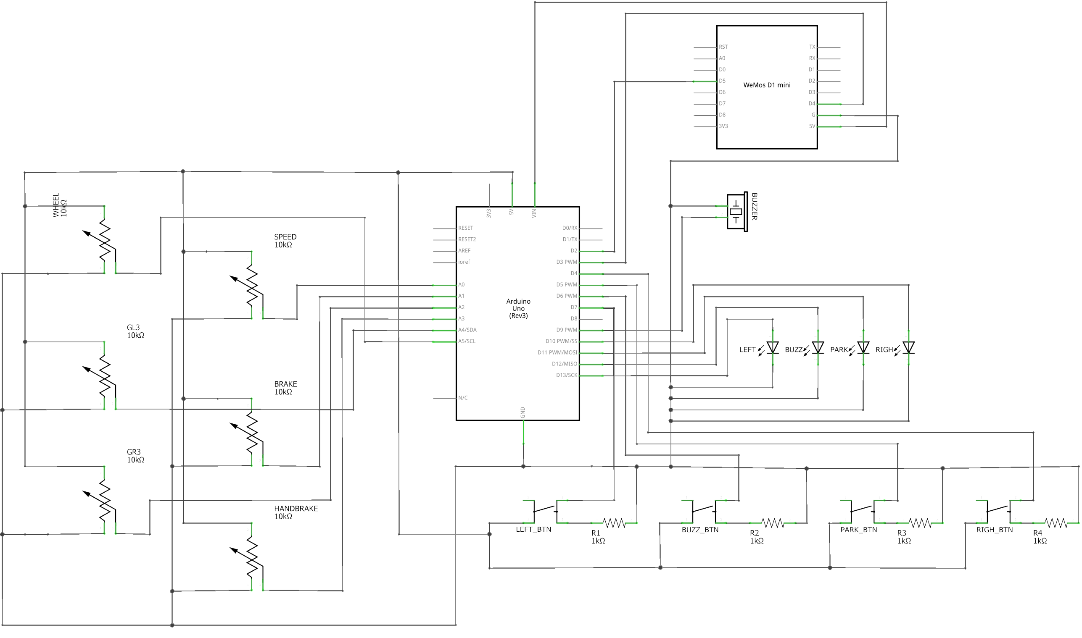
Hardware Design
Schematic (continue)

Slide 25
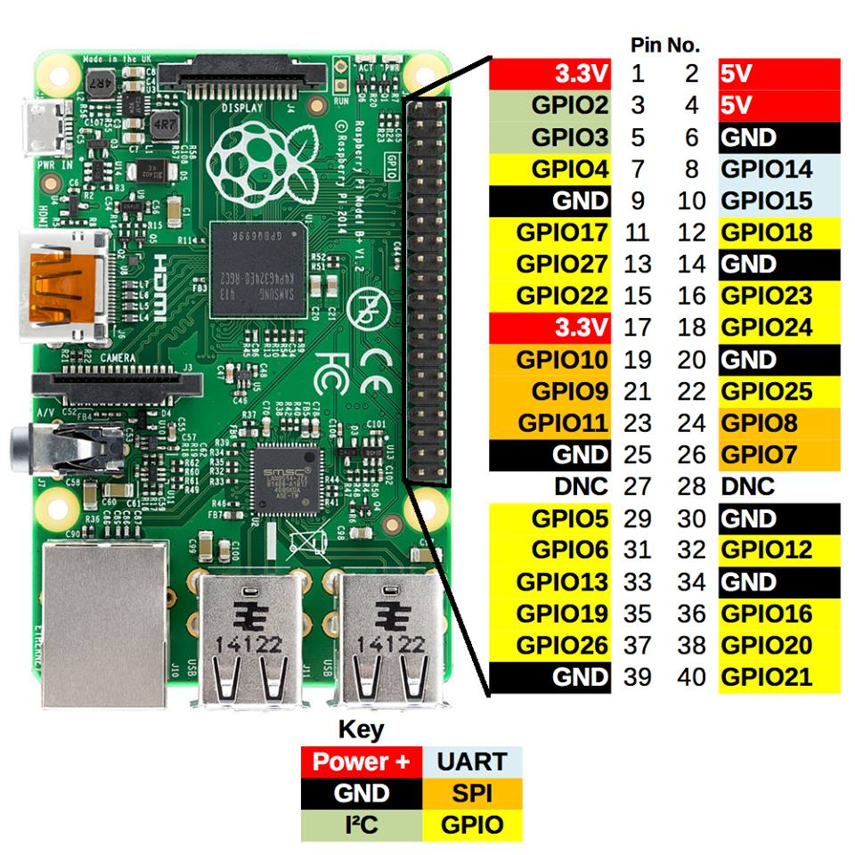
Hardware Devices
Raspberry Pi 3 Model B
Processor | Broadcom BCM2837 SoC with a 1.2 GHz 64-bit quad-core ARM Cortex-A53 processor, with 512 KB shared L2 cache
GPU | Broadcom VideoCore IV @ 250 MHz OpenGL ES 2.0 MPEG-2 and VC-1
Memory | 1GB
Operating System | Boots from Micro SD card, running a version of the Linux operating system or Windows 10 IoT
Network | 10/100 Mbit/s Ethernet, 802.11n wireless built-in, Bluetooth 4.1
GPIO Connector | 40-pin 2.54 mm (100 mil) expansion header: 2x20 strip Providing 27 GPIO pins as well as +3.3 V, +5 V and GND supply lines

Slide 26
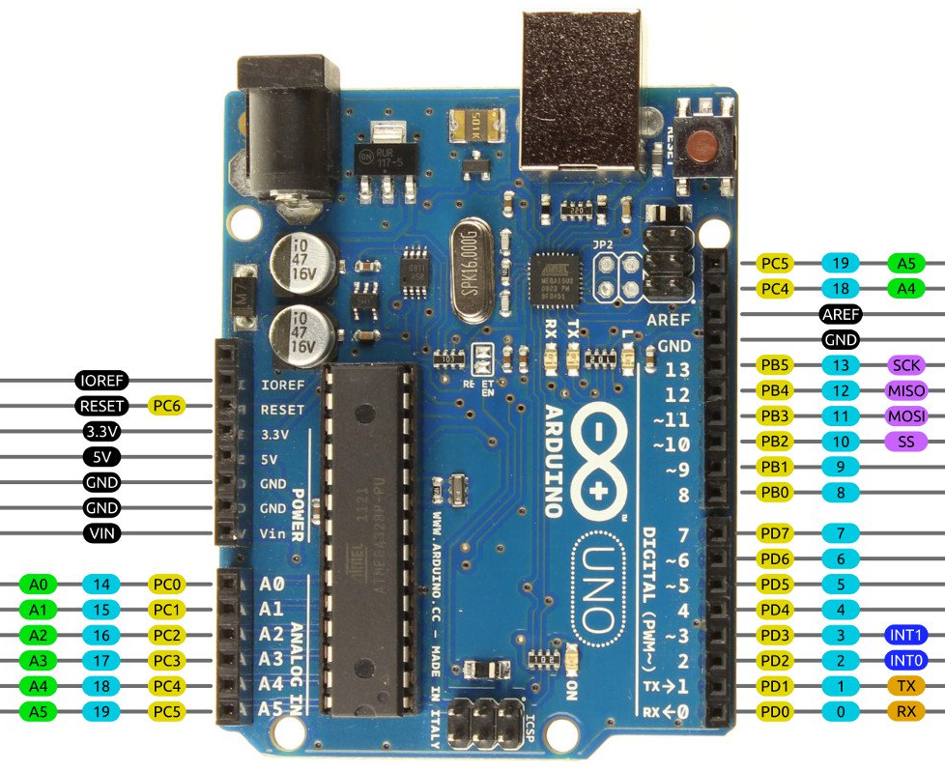
Hardware Devices
Arduino Uno R3
Microcontroller | ATmega328
Architecture | AVR
Operating Voltage | 5V
Flash memory | 32KB of which 0.5 KB used by bootloader
SRAM | 2KB
Clock Speed | 16 MHZ
EEPROM | 1 KB
DC Current per I/O pins | 40 mA on I/O pins; 50 mA on 3.3V pin
Input Voltage | 7 – 12 V
Digital I/O pins | 20
Analog I/O Pins | 6
Board Dimensions | 68.6mm x 53.4mm

Slide 27
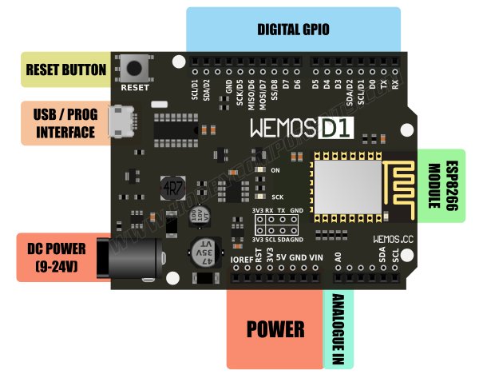
Hardware Devices
WeMos D1
Microcontroller | ESP8266
Operating Voltage | 3.3V
Input Voltage Range | 9V to 24V
Output | 5V at 1A max
Digital I/O pins | 11
Analog input pins | 1
Flash Memory | 4MB
Board Dimensions | 68.6mm x 53.4mm
Weight | 21.8g

Slide 28
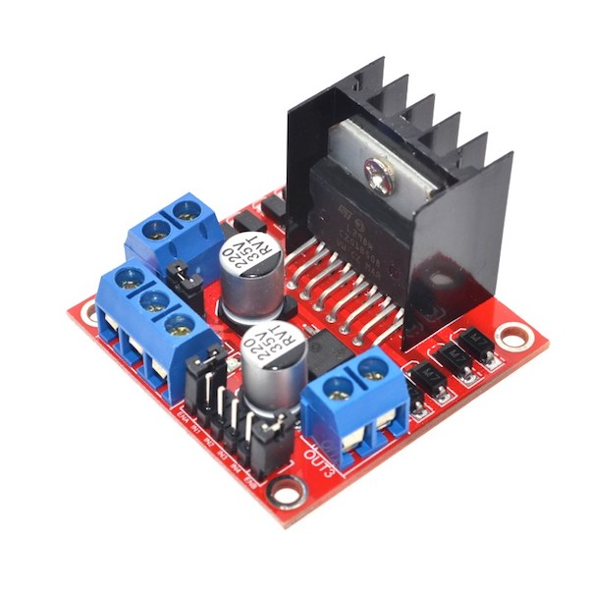
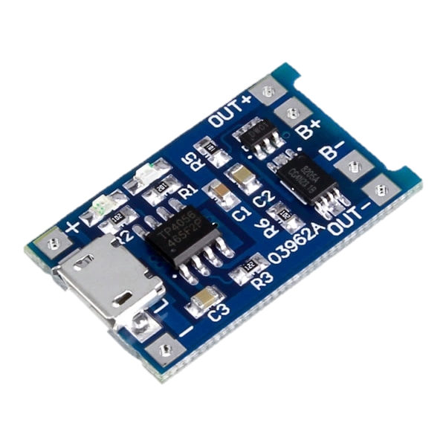
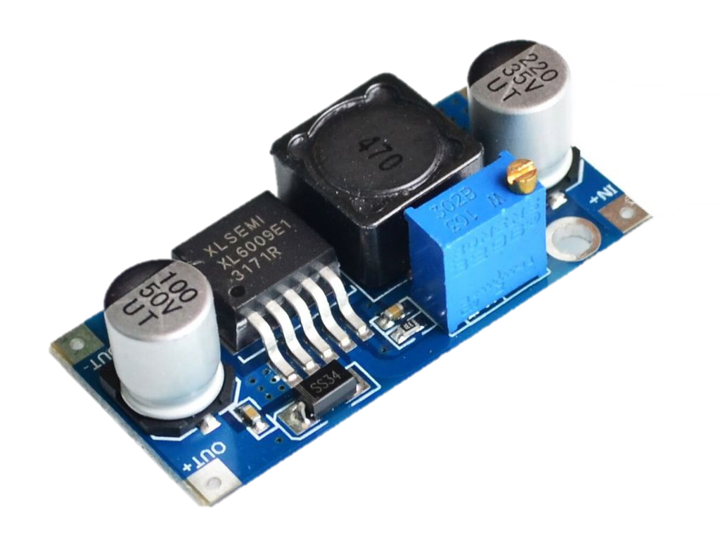
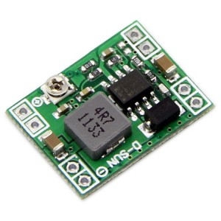
Hardware Devices
Other modules
L298N
Motor Controller
TP4056
Charging circuit
XL6009
Switching Current Boost
MP1584
Step-down Regulator
Power supply | +5 V ~ +35 V
Peak output current | 2A/channel
Logic power output | +5 V ~ +7 V
Logic current | 0 ~ 36mA
Max power | 20W(Temperature 75 ℃)
Working temperature | -25 ℃ ~ +130 ℃
Input voltage | 4.5 ~ 5.5V
Full charge voltage | 4.2V
Working temperature | -10­­ºC ~ +85ºC
Charging Current | 1A
Input voltage | 3.2V ~ 32V
Output Voltage | 4V ~ 38V
Rated output current | 3A
Peak Output Current | 4A
Conversion efficiency | Up to 94%
Voltage input | 4.5-28V
Voltage output | 5V
Current output | 3A
Size | 22x17mm

Slide 29
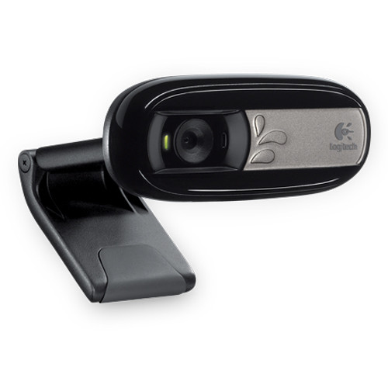
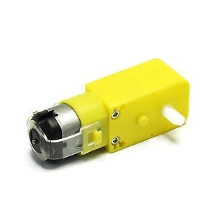
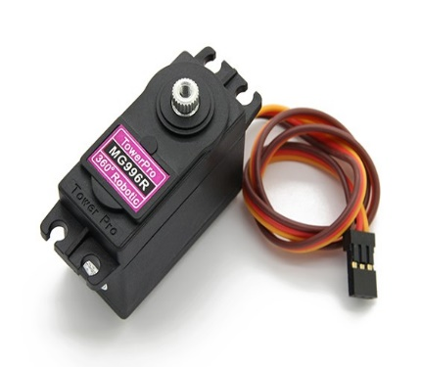
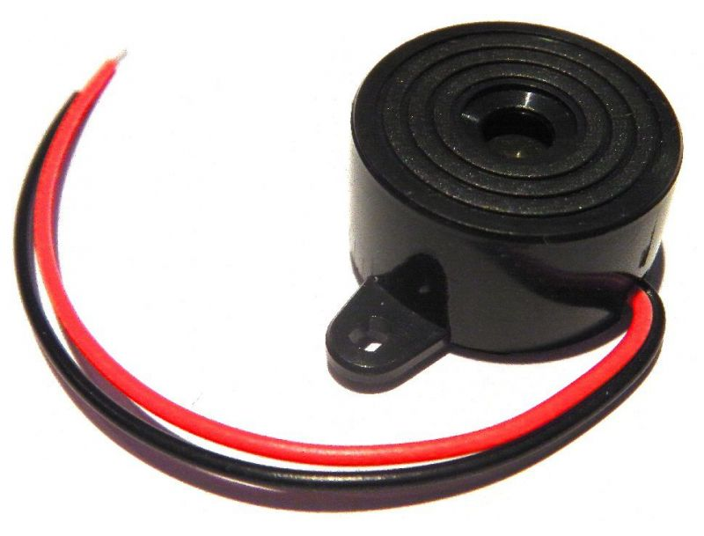
Hardware Devices
Equipment
1
2
Gear speed-reducer
DC Motor
Logitech C170
2
1
Servo MG996
Buzzer

Slide 30
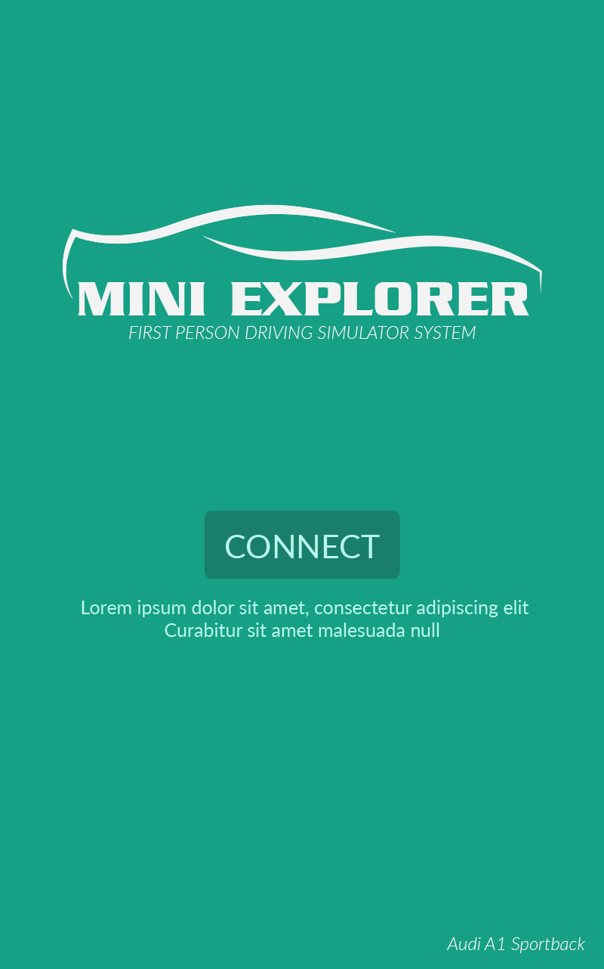
Android Client Application
Welcome Screen
Introduce to device connection

Slide 31









Android Client Application
Controller Mode
Control with streaming media
from Automobile Model
Virtual Reality Mode
Experience the first person view
with VR Glasses

Slide 32
Application Design
End
F
Start
Is Wi-Fi
Available?
Disconnect
To Server
Welcome Screen
T
T
Try to connect to server
Get Server Address
Get data in
Control Mode
The request is
Disconnect?
F
Send data
To Server
F
Connect to
server successful?
T
Control Mode View
Receive data from server
F
Change to
VR Mode?
T
VR Mode
View
Get data in
Control Mode
Tab Back

Slide 33
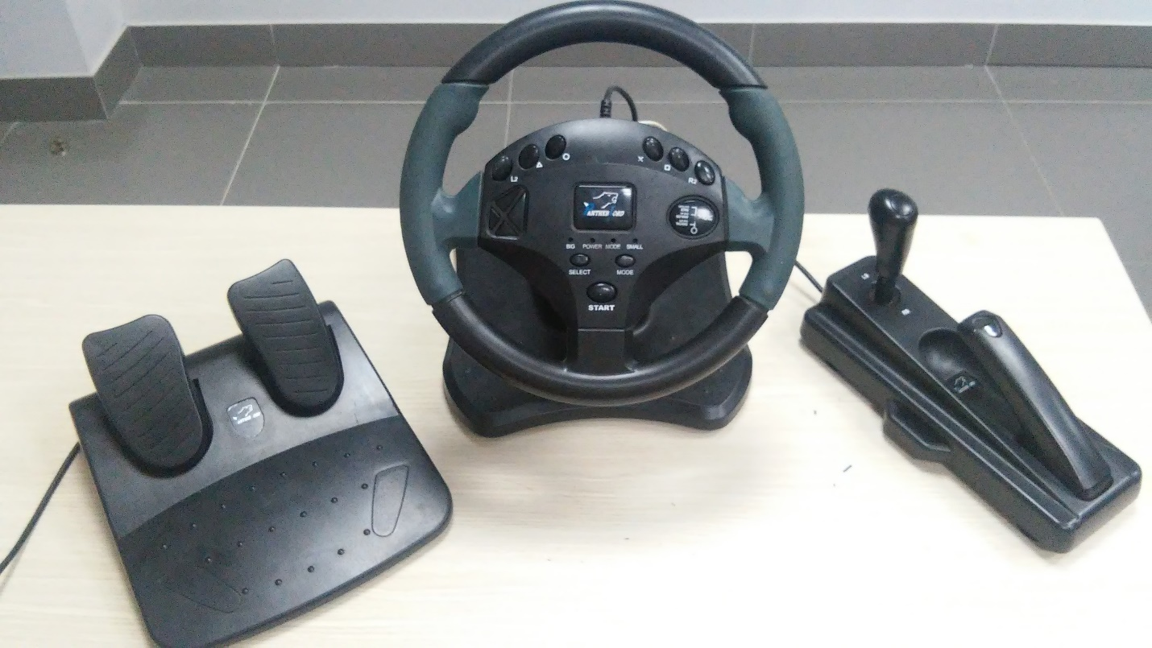
Remote Controller
Arduino & WeMos inside
Collect data from Rotary resistance
and Button

Slide 34
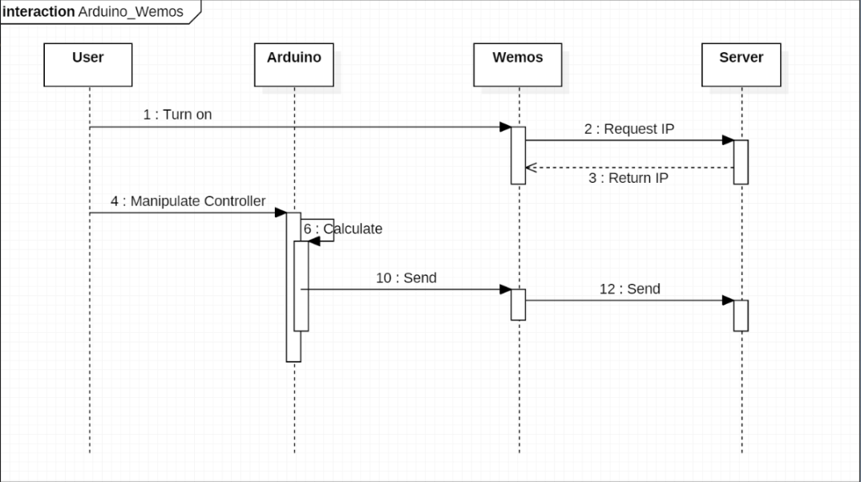
Firmware Design

Slide 35
Testing

Slide 36
PRODUCT DEMO

Slide 37
QUESTION AND ANSWER

Slide 38
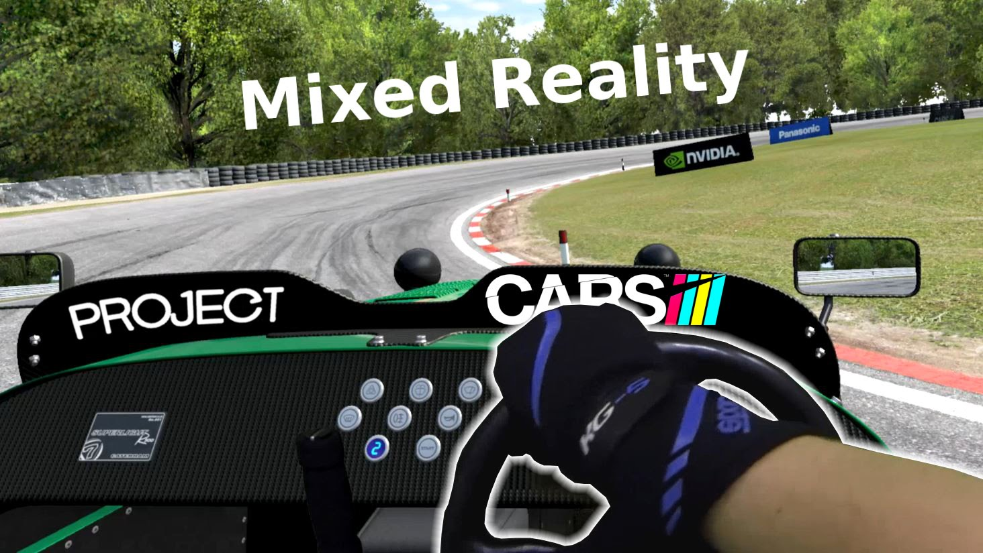


Future Work

Slide 39
LESSON LEARNED

Slide 40

THANK YOU

